Slide 1
Powerwall Interaction with VR Controllers
Denis Makarov, Alpin Turkoglu, Dang Mai 11.02.2020

Slide 2
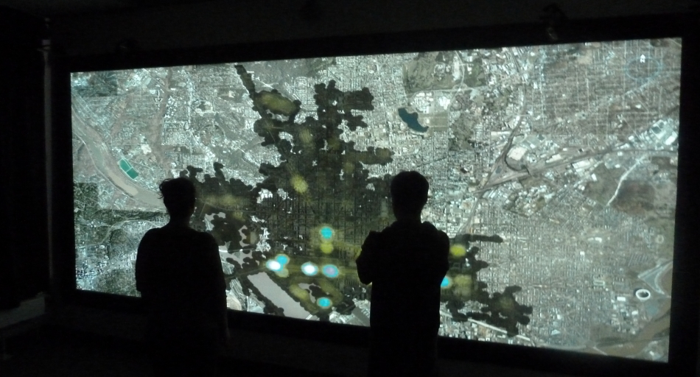
Motivation
Large screen and resolution
https://www.vis.uni-konstanz.de/forschung/powerwall/

Slide 3
Motivation
Large screen and resolution
Difficult interaction using the mouse
https://www.vis.uni-konstanz.de/forschung/powerwall/

Slide 4
Motivation
Large screen and resolution
Difficult interaction using the mouse
Using VR controllers
https://www.vis.uni-konstanz.de/forschung/powerwall/

Slide 5
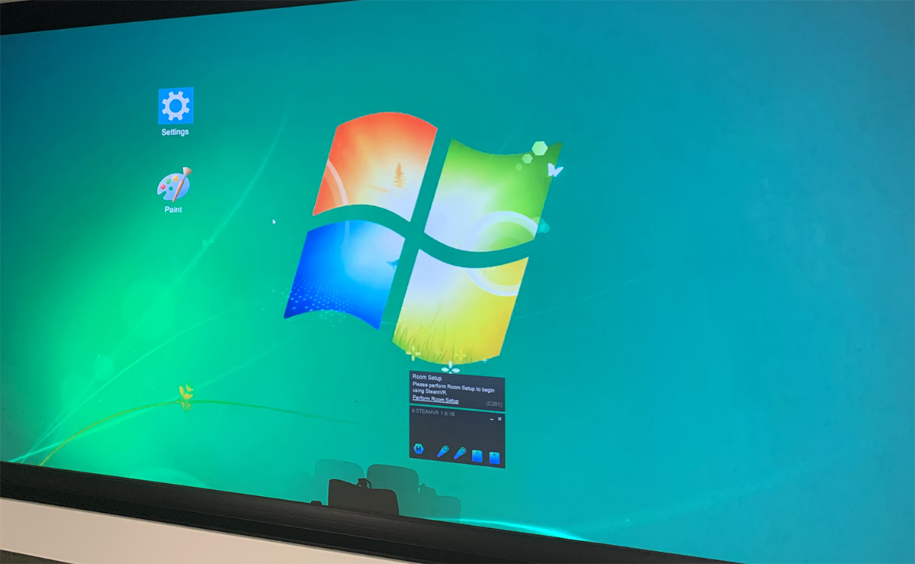
Idea
Unity VR
VR application
“Like” Windows OS
Paint app

Slide 6
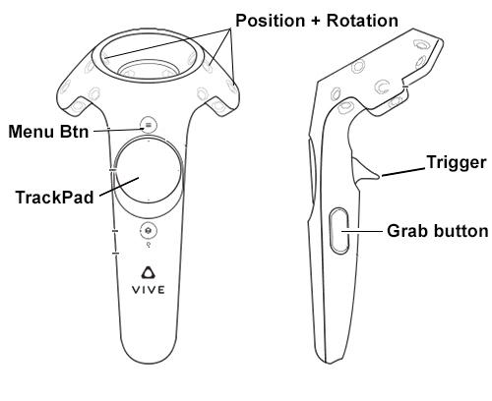
Idea
Unity VR
VR application
“Like” Windows OS
Paint app
HTC Vive controllers

Slide 7
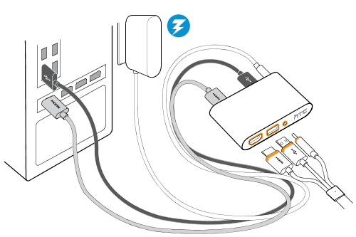
Headset Configuration
Goals:
Using VR Controllers independently
Connecting Headset without HMD Displayport
Solution: Extra configurations to set null driver for the headset

Slide 8
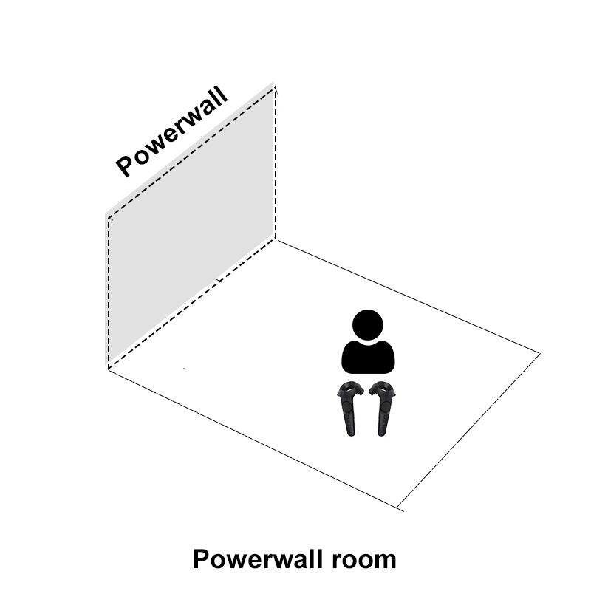
Implementation
Virtual space setup:
Duplicate real space of Powerwall room in virtual space
Canvas as Powerwall
Static camera

Slide 9
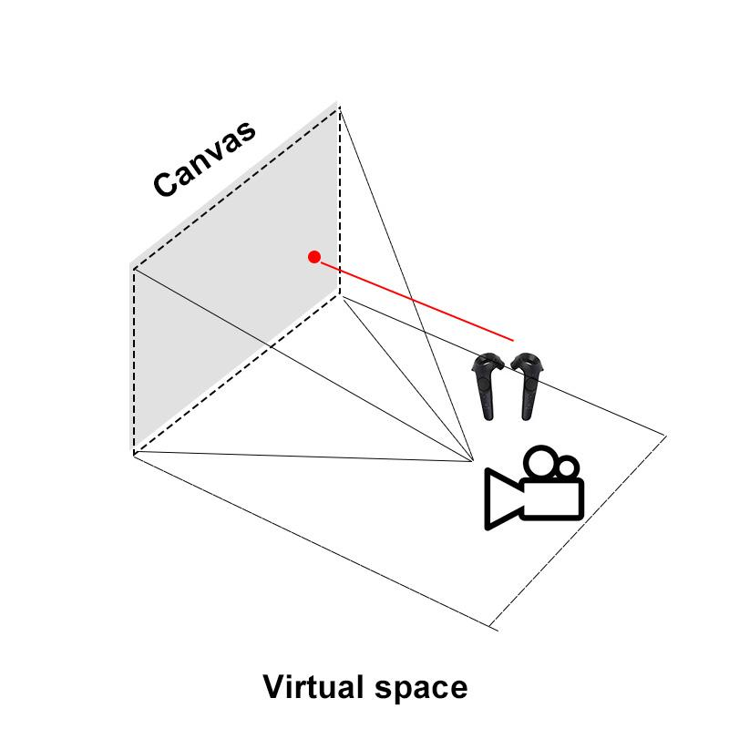
Implementation
Virtual space setup:
Adjusted space size
Correct canvas position
Point out from different positions

Slide 10
Implementation

Slide 11
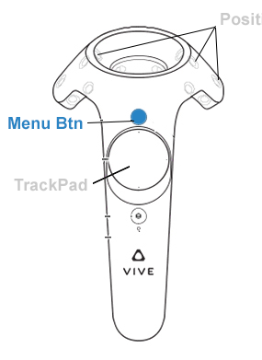
Calibration

Slide 12
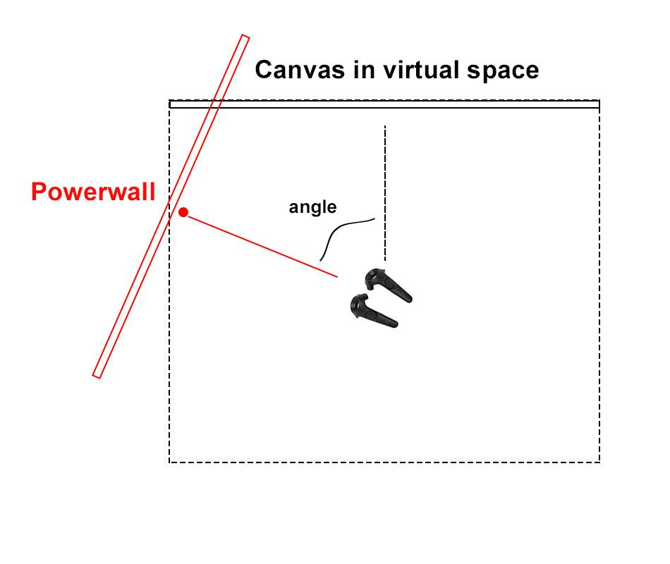
Calibration
Incorrect initial direction of controllers
Angle calculation
Controllers rotating

Slide 13
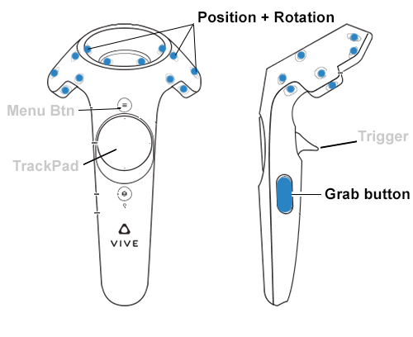
Zoom in / out + Position

Slide 14
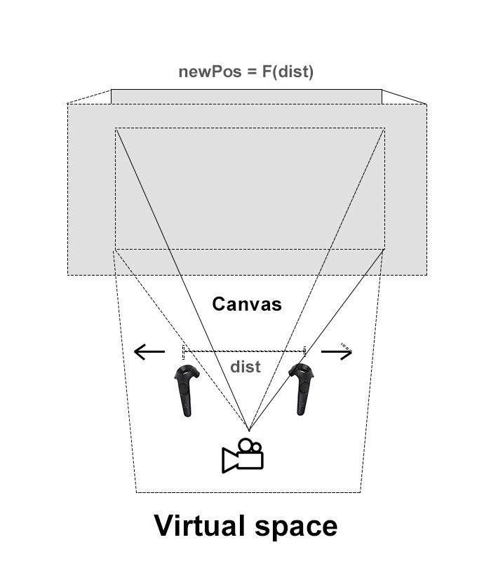
Zoom in / out + Position
Zoom degree
Dist (Contr1, Contr2)
canvasPosZ = F (Dist)

Slide 15
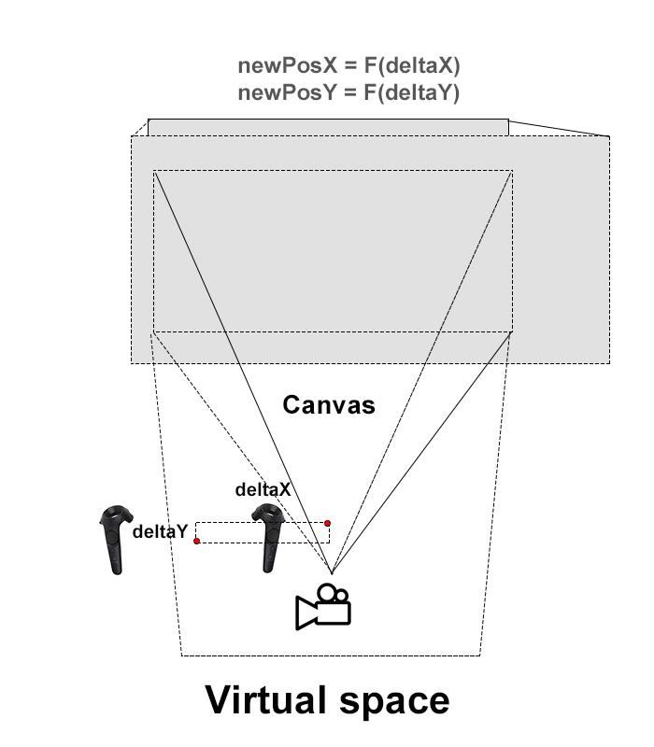
Zoom in / out + Position
Zoom degree
Position changing
deltaX, deltaY
canvasPosX = F(deltaX)
canvasPosY = F(deltaY)

Slide 16
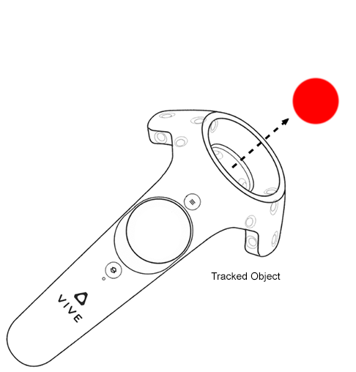
Drawing
3D Sphere object as a ‘Colorful dot’
Tracked by the controllers
Position determination according to World Space Canvas

Slide 17
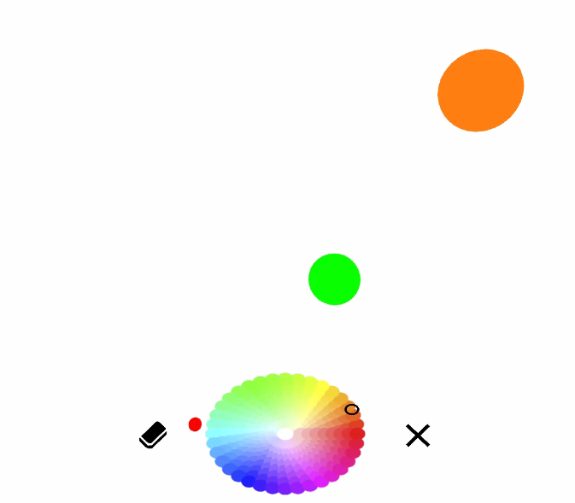
Creating Shapes
Drawing shapes with controllers:
Sphere / Cube
Controllers x and y values are used to determine average distances
Simple Threshold value is used
Notes:
Bounding boxes can be used -> aspect ratio == 1 with the bounding box then it is a rectangle or square
triange fills the less area
For the circularity condition, I used the ratio between perimeter and area

Slide 18
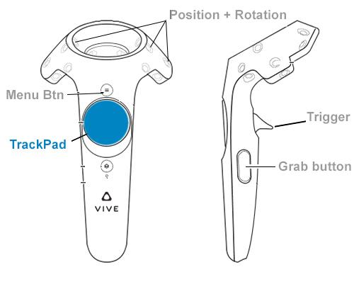
Color Picker

Slide 19
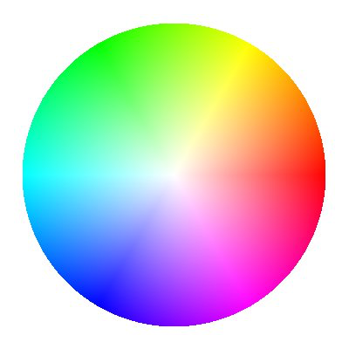
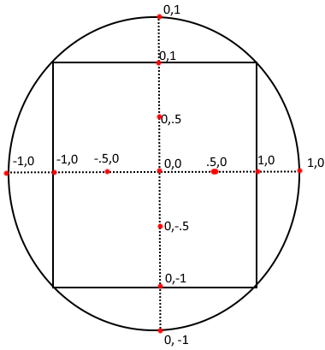
Color Picker
TrackPad value (X, Y)
Polar coordinates (R, angle)
HSV color space
H = angle
S = R
V = 255
HSV palette
TrackPad

Slide 20
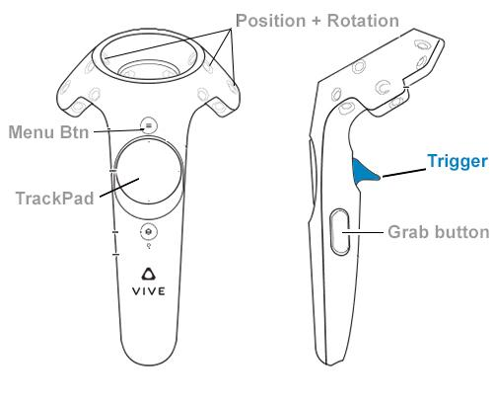
Brush size

Slide 21
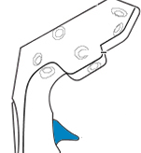
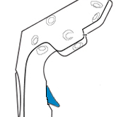
Brush size
Trigger push degree
Value = [0, 1]
Brush size = F (Value)
Value = 0.3
Value = 1
Brush size:

Slide 22
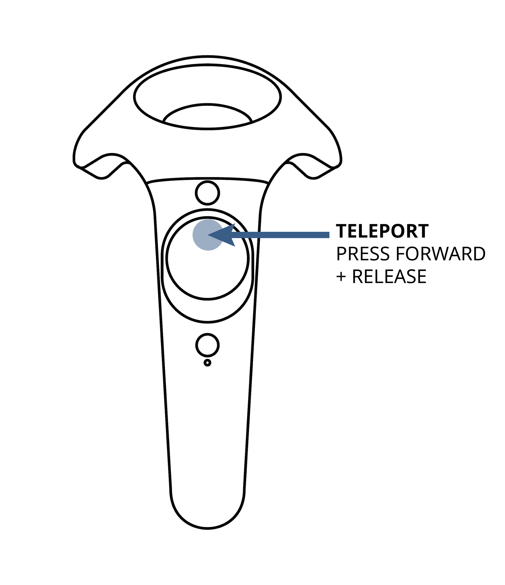
Other UI Interactions
Drag & Drop
Click Interaction

Slide 23
LIVE DEMO

Slide 24
Discussion
WebVR API
Less data from controller
Work in browsers
Calibration
Powerwall size (corners)
Drawing Shapes in Motion
Bounding Boxes

